Slide 1

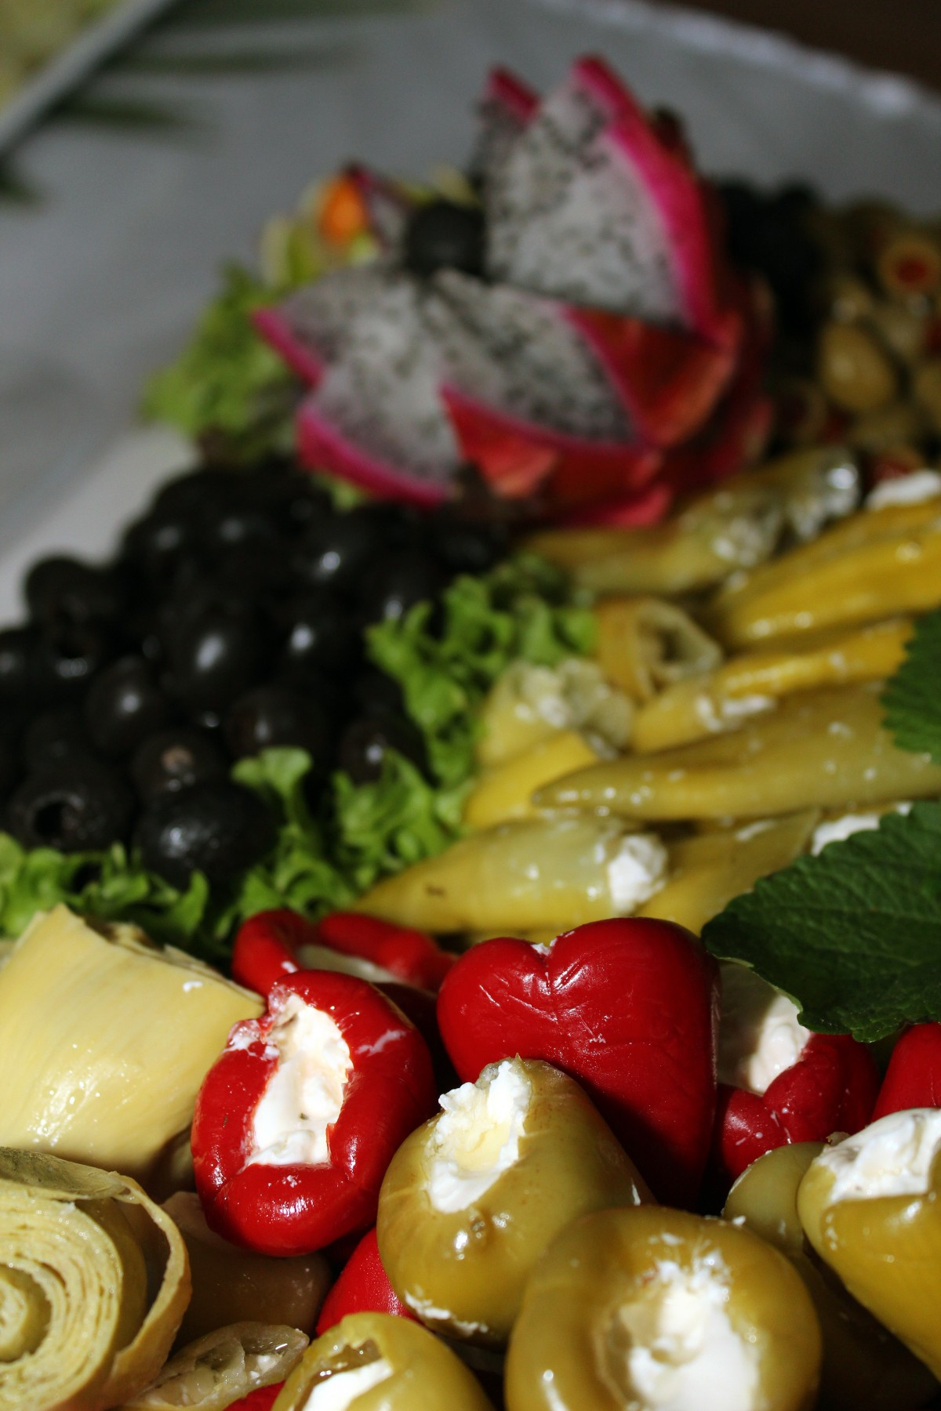
Food service company
Name: Dolly Khatun
Batch:22
Roll: 01-022-18

Slide 2
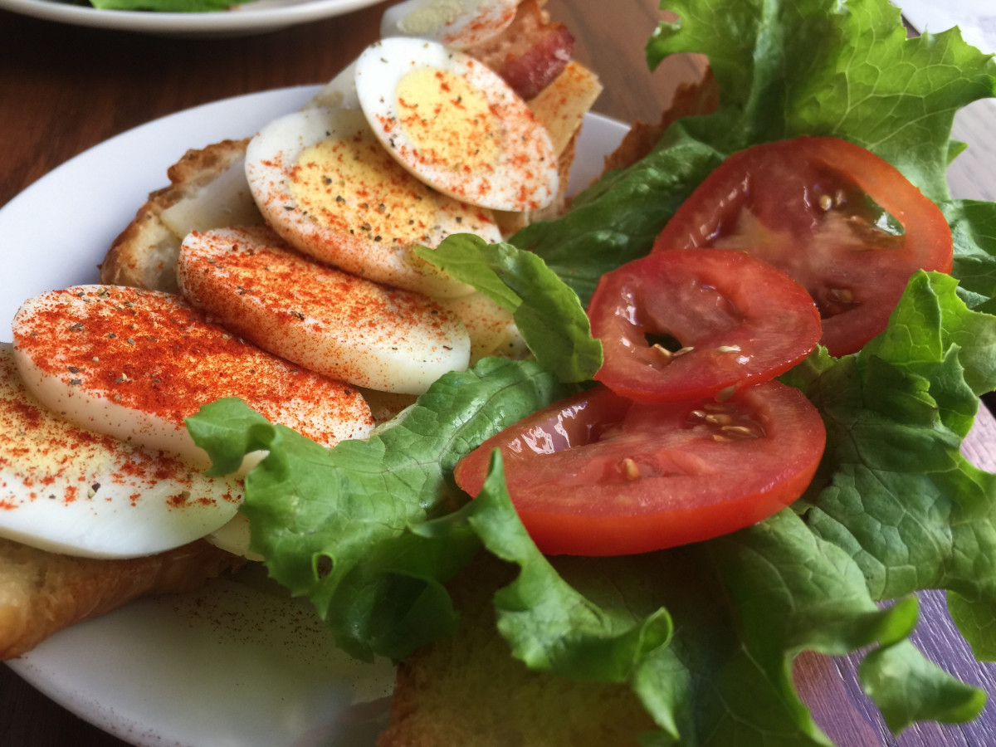
Brief introduction to the company
The University of Massachusetts Extension office serves the commonwealth by providing
• Short course trainings related to food science
• Food Science research support
• Access to the Pilot Plant for research and development The Pilot Plant at the flagship campus in Amherst, Massachusetts holds a number of specialized industrial equipment pieces to conduct research that may assist businesses in their product or process development. There are many elements to starting a food business.

Slide 3
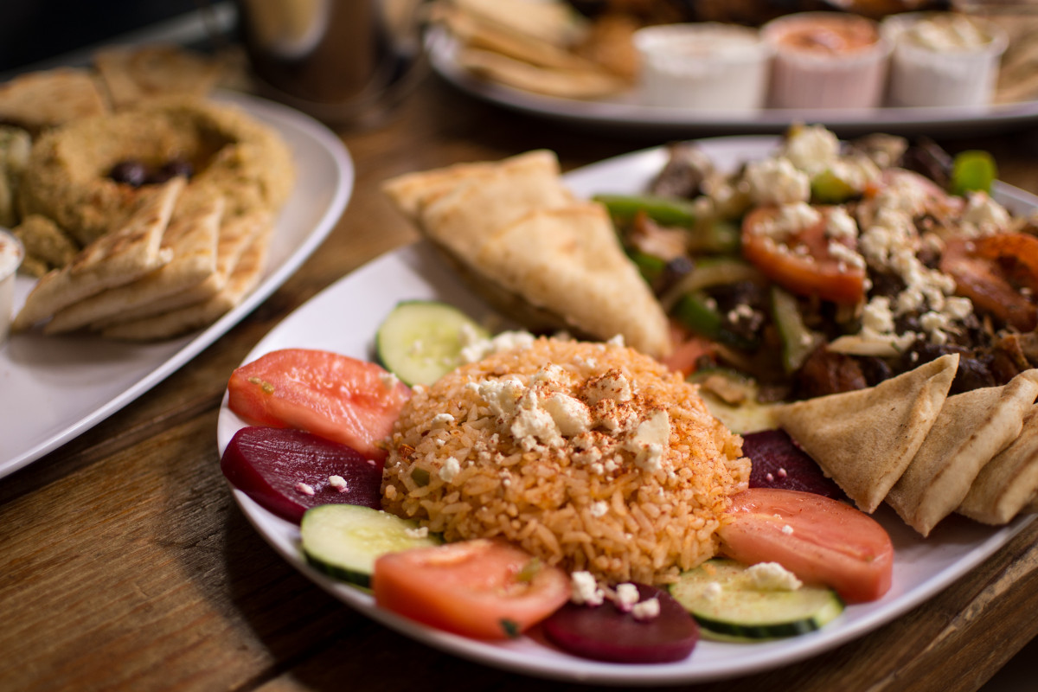
Key products and services
Whether you have decided to bring a product to market on your own or you’ve chosen to work with an established co-manufacturer, selecting the right ingredients for your new product is the next step towards a winning creation. You might be asking yourself why ingredient choices are included in the five key elements for developing your food products as you already know what ingredients make your fluffy biscuits so popular with your family and friends. What you might not realize is ingredient sourcing will:
Dictate the quality of your product
Define potential ingredient substitutions – critical to taste and function
Adjust your formula as you scale to larger production runs
Directly affect the overall development time

Slide 4

Analyze the company’s statistical data

Slide 5
COMPARISON

Slide 6

ADVERTISEMENT

Slide 7
THANK YOU

